Slide 1
Firewall 1/2
Made by John Hallam & Mathias Neerup

Slide 2
Agenda
What is a firewall ?
General security
Firewall design
Protocols
Setup webserver
Protocol sniffing
Exercises
WIFI cracking by Thor
Firewall implementation
Scapy (python experience?)
Various iptables tricks & fun
Policy based routing

Slide 3
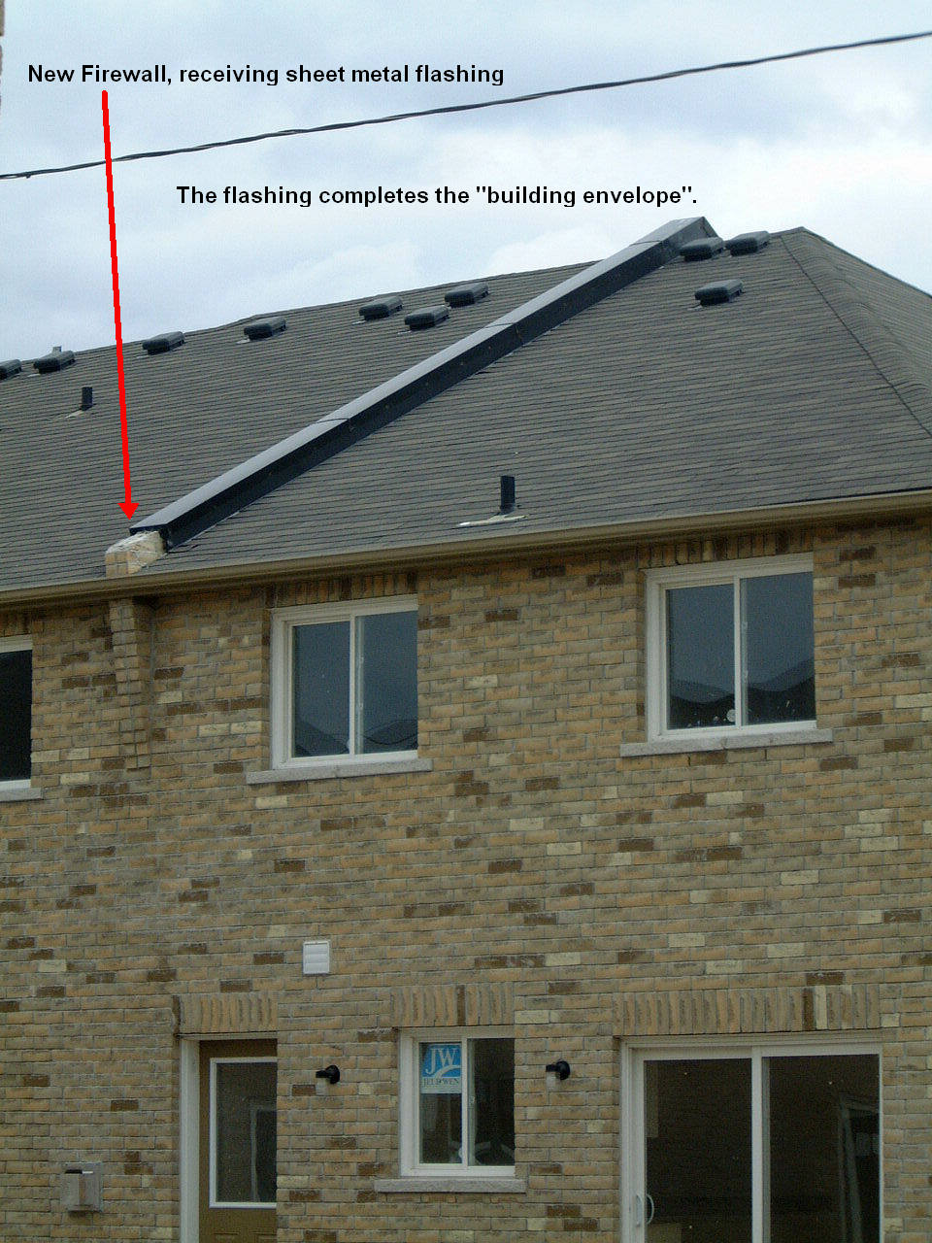
What is a firewall ?

Slide 4
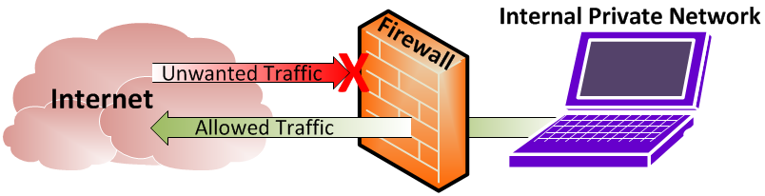
What is a firewall ?

Slide 5
Why do we need a firewall?
Protect data
Secrecy
Integrity
Availability
Protect resources
Your identity
Notes:
You want to protect your data, which is usually to keep data safe(business information). But you don’t want people to change the data, and you want the data to be avilable to yourself - otherwise, why waste space on it.
You want to project resources, you don’t want people to use disk, cpu, memory osv.
You don’t want people to be “you” on the internet - not if you have special permissions to certain systems. Ex. spam

Slide 6
What are we protecting against?
Types of attacks
Intrusion
Denial of service
Flooding attacks
Information theft
Network sniffing (network tap)
Type of attackers
They want to hide
Joyriders
Bored
Vandals
Evil
Scorekeepers (script kiddies)
Keep score of “hacks”
Spies
Serious “hackers”
Money
Stupidity and accidents
Notes:
Intrusion: people logging into your systems (social engineering,
DoS: Loose access to service because you run out of resources.
Flooding attacks are relatively easy to do, but you don’t gain alot “some people just want to see the world burn”
information theft, people claim to be another person, the other person gives out the information etc.
Attackers won’t reveal their identity and location

Slide 7
Security models
No security
Security by obscurity
Security by design
Secure by default
Host security
Network security
Notes:
Intrusion: people logging into your systems (social engineering,
DoS: Loose access to service because you run out of resources.
Flooding attacks are relatively easy to do, but you don’t gain alot “some people just want to see the world burn”
information theft, people claim to be another person, the other person gives out the information etc.
Attackers won’t reveal their identity and location

Slide 8
Security models
Security strategies
Least privileges
Defense in Depth
Diversity of defense
Weakest link
Fail-safe stance
Notes:
Intrusion: people logging into your systems (social engineering,
DoS: Loose access to service because you run out of resources.
Flooding attacks are relatively easy to do, but you don’t gain alot “some people just want to see the world burn”
information theft, people claim to be another person, the other person gives out the information etc.
Attackers won’t reveal their identity and location

Slide 9
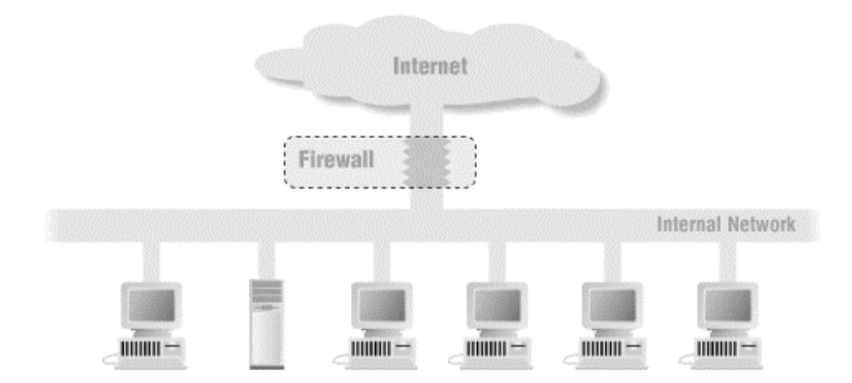
What is an internet firewall?
Notes:
Intrusion: people logging into your systems (social engineering,
DoS: Loose access to service because you run out of resources.
Flooding attacks are relatively easy to do, but you don’t gain alot “some people just want to see the world burn”
information theft, people claim to be another person, the other person gives out the information etc.
Attackers won’t reveal their identity and location

Slide 10
What is an internet firewall?
Focuses security decisions
Enforces security policy
Logging activity
Limit exposure
Attack surface
Inbound/outbound controlled point (movie)
Notes:
no spreading out security decisions, at collected at one point
Enforces security policy by allowing or rejecting traffic between computers

Slide 11
What a firewall can’t do
Insiders
Dial-up connections
Virus
Can’t configure themself
Notes:
insiders, employees going rogue
Dial-up, 4G connection from phone
Virus, some deep inspection is possible, get back to that in a minute
Can’t configure themself, has to be done by human

Slide 12
Types of firewalls
Shallow packet inspection (stateful packet inspection)
Deep packet inspection
Application-level gateways (proxy)
logging advantage
Notes:
Intrusion: people logging into your systems (social engineering,
DoS: Loose access to service because you run out of resources.
Flooding attacks are relatively easy to do, but you don’t gain alot “some people just want to see the world burn”
information theft, people claim to be another person, the other person gives out the information etc.
Attackers won’t reveal their identity and location

Slide 13
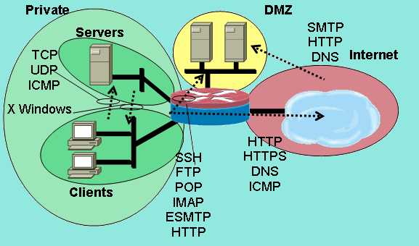
Firewall Policy
Zones

Slide 14
Firewall Policy
Zones
Backup
VPN users
Hypervisors
Virtual Machines
Management
IoT
Guest
…
Default policy
default deny
allow specific traffic
default permit
deny attacks
Notes:
generally give the least pvigileges required
Don’t rely on only one solution, but have several “backups”, ex. 2 firewalls of different brand,
weakest link, the chain is not stronger than the weakest link. physical security, network security, identify your weakest link.
How do you want you system to fail.
leave all doors locked or unlocked if lock fails ?
Diversity of defence: Use firewalls of different vendors (use lock and alarm on car, not just differnet locks)
default deny, only allow specific traffic
might annoy the user
default accept, deny attacks
the attacks might happen before the admin blocks them

Slide 15
Firewall Policy
Packet actions
Accept
Drop
Reject
Between zones
Implementation
Physical separation
VLAN separation
Notes:
accept: allow connection
Drop: don’t provide feedback to source, just drop and ignore
Reject, tell the source it’s a “nono”

Slide 16
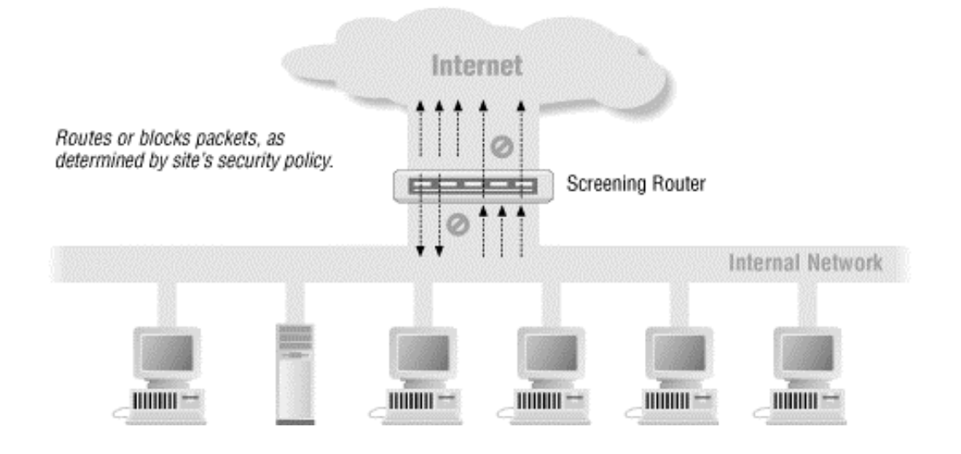
Firewall in a network
Notes:
screening router:
typically used between ISP and consumer
Route packets, NAT, accept/reject/drop packets based on layer 3 knowledge

Slide 17
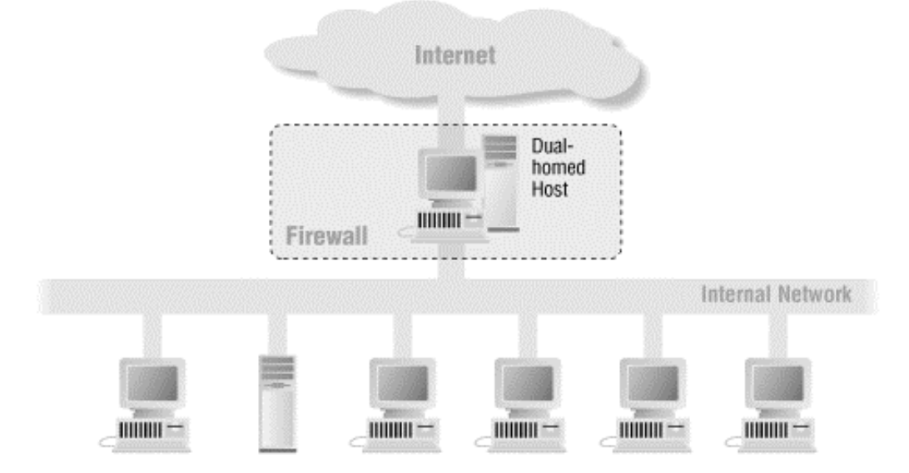
Dual-homed(two interfaces) Host
Notes:
more heavy load than screening router
Can run a proxy

Slide 18
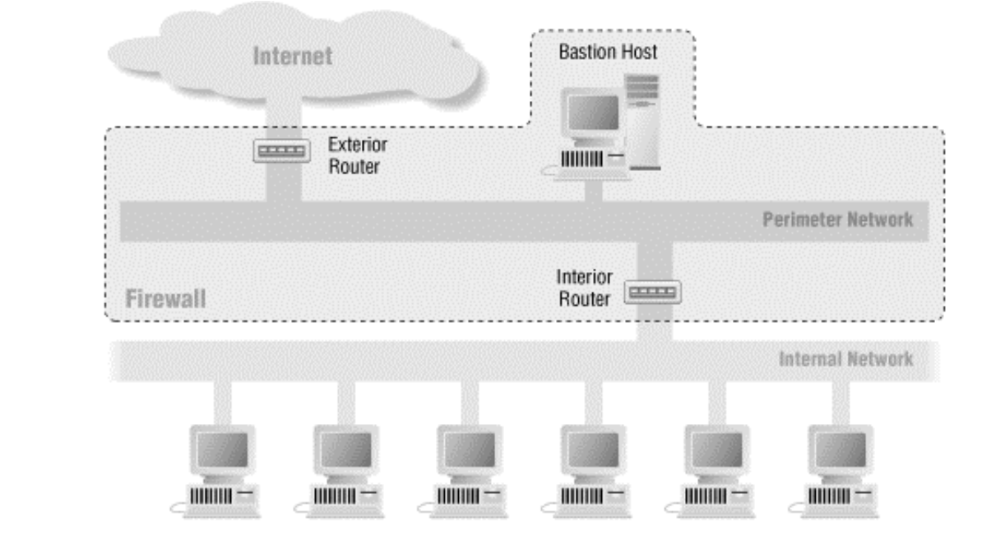
Screen subnet architecture
Single-point-of-failure
High Availability
Break - 10 min!

Slide 19
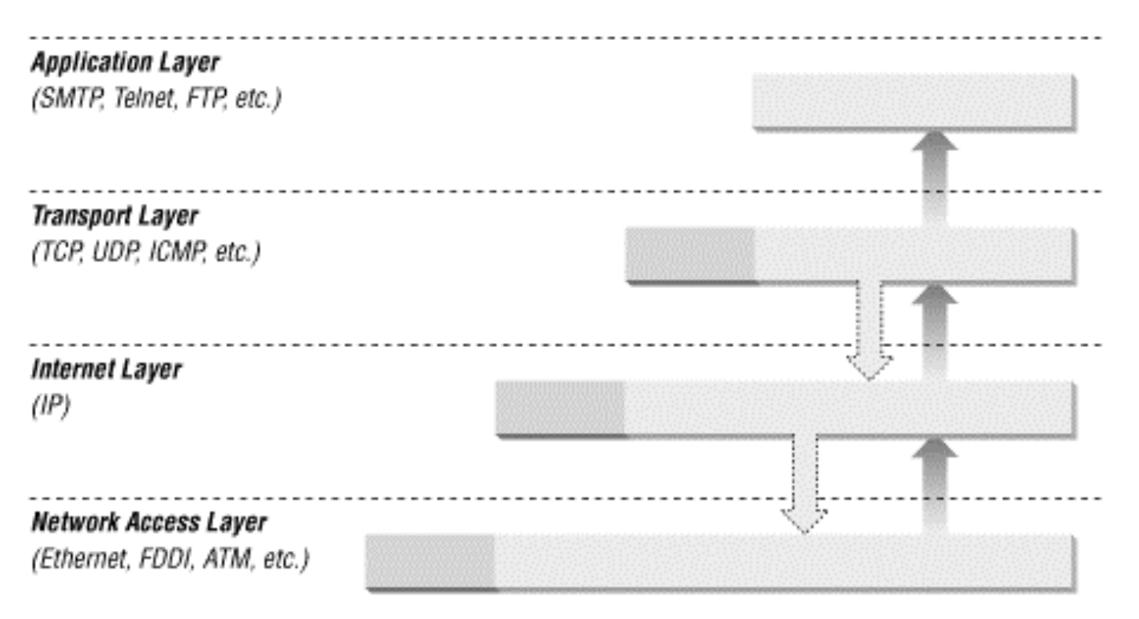
Network stack

Slide 20
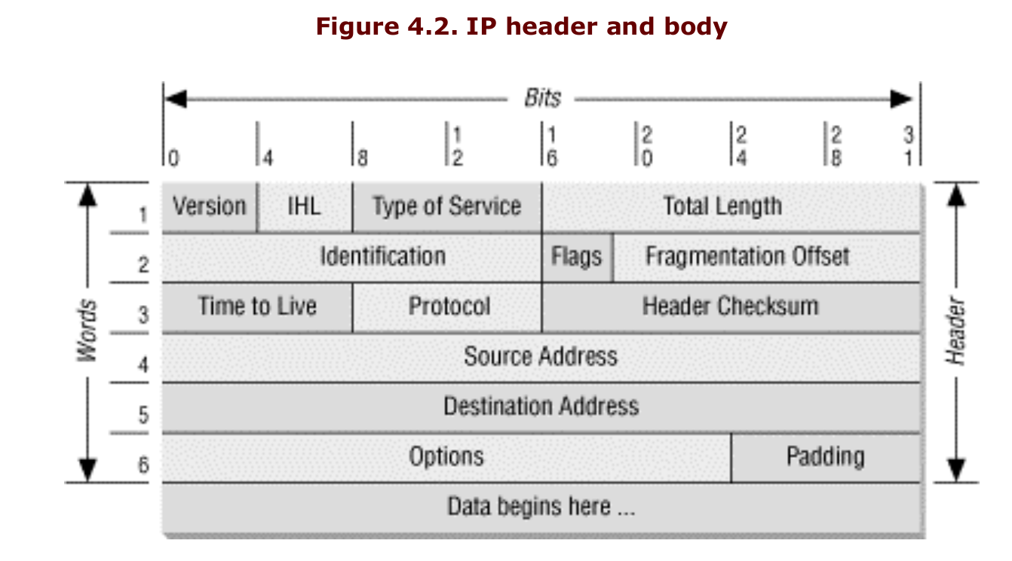
IP header (layer 3)

Slide 21
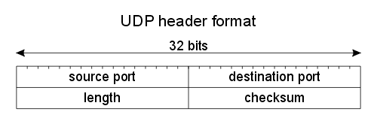
UDP header (layer 4)

Slide 22
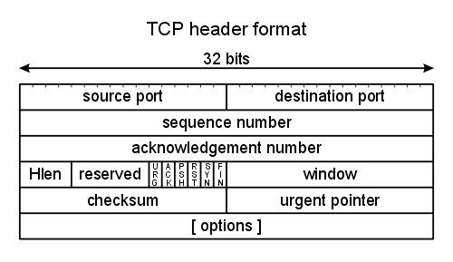
TCP header (layer 4)

Slide 23
TCP header (layer 4)
Stateful firewall
Deep packet inspection

Slide 24
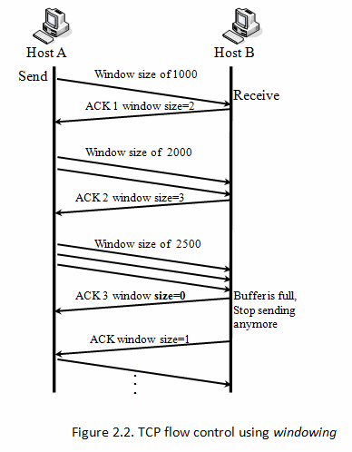
TCP header (layer 4)

Slide 25
TCP header (layer 4)
2.5

Slide 26
TCP header (layer 4)
2.5

Slide 27
TCP header (layer 4)
Tarpitting
Don’t track connections
2.5

Slide 28
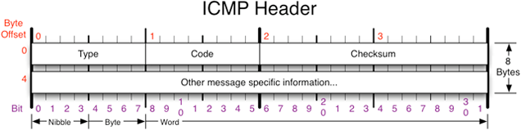
ICMP
Echo request
Echo reply
Time exceeded
Destination unreachable
…
Permit
Notes:
time exceeded

Slide 29
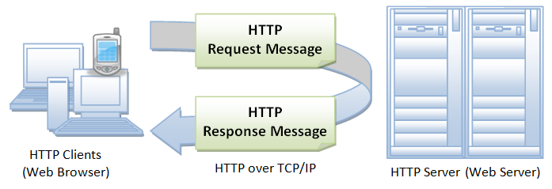
HTTP protocol

Slide 30
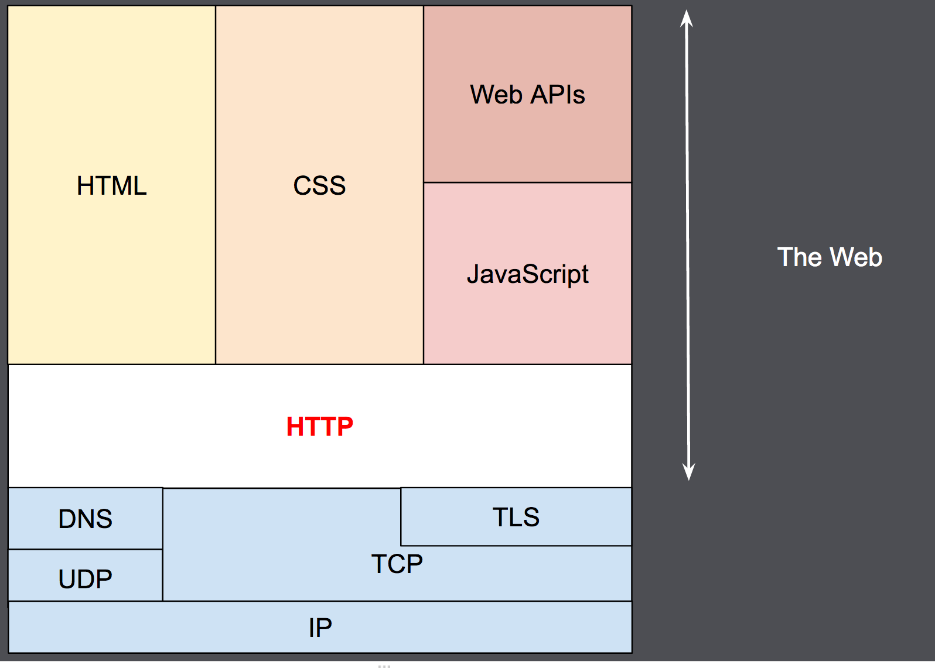
HTTP protocol

Slide 31
Wireshark
Debug network
Debug protocols
Write dissector in LUA
Run on remote host (tcpdump, tshark)
Decryption
Understanding

Slide 32
Exercise 1/2
Install wireshark (sudo apt install wireshark -y)
Start wireshark (as root)
Listen on wifi interface
Familiarize yourself with wireshark example by browsing, ping’ing, socat, nmap etc.
(15 min)

Slide 33
SSH port forwarding
Local port forwarding
Forward local port on client to port on server
Remote port forwarding
Forward remote port on server to local port on client
Dynamic forwarding
Proxy

Slide 34
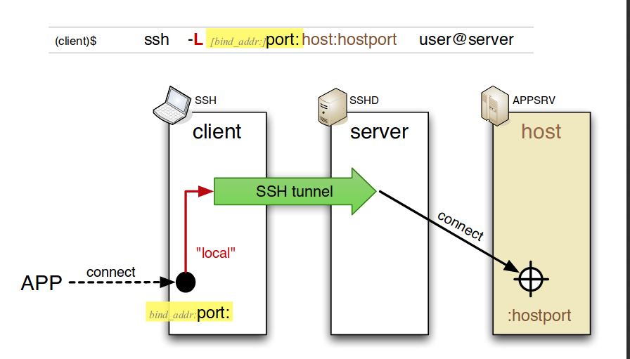
SSH port forwarding
Local port forwarding
ssh -L 80:intra.example.com:80 gw.example.com -L ..

Slide 35
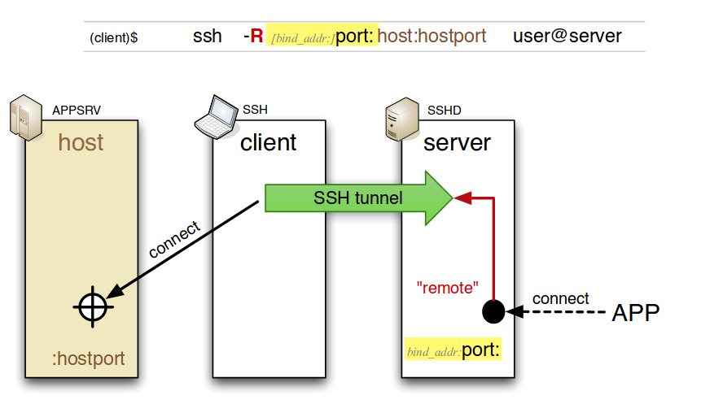
SSH port forwarding
Local port forwarding
ssh -L 80:intra.example.com:80 gw.example.com -L ..
Remote port forwarding

Slide 36
SSH port forwarding
Local port forwarding
ssh -L 80:intra.example.com:80 gw.example.com -L ..
Remote port forwarding
Dynamic forwarding
ssh -D 8080 user@host

Slide 37
Exercise 2/2
Install webserver/service on RPIxy (apache2, nginx, lighttpd, socat, whatever)
Create SSH tunnel that forwards port 80 on RPI to your laptop (putty if windows)
Access website/service from PC
(30 min)

Slide 38
Next time
From firewall policy & protocols => Implementation
Iptables
DNAT/SNAT
Other firewall solutions
Scapy (python module)
Play with DNS
Create malicious packets
Iptables fun
If you wanna know more:
http://dbmanagement.info/Books/Others/O%27Reilly_Building_Internet_Firewalls_2nd_Edition.pdf

